Slide 1
Computer Organization & Architecture Unit – 1
Presented By : Mrs. Seema Ranga State Institute of Engineering & Technology, Nilokheri Department : Computer Engineering

Slide 2
INTRODUCTION TO COMPUTER SYSYTEM
A computer system is defined as a digital electronics device that can be programmed to accept some inputs in terms of data, then process this data as per the program instructions and provide the output in the desired format that can be used for some meaningful work. The computer system is programmable. That means, the computer will perform the task only as per the program instructions.
The computer system consist of both software components and hardware components. The hardware components are physical parts that we can touch and interact. Whereas, the software is essential to drive the hardware.

Slide 3
user → input→application software→operating system→output

Slide 4
Computer Organization
The computer organization is concerned with the structure and behavior of digital computers. The main objective of this subject to understand the overall basic computer hardware structure, including the peripheral devices.
In spite of variety and pace in the computer field, certain fundamental concepts apply consistently throughout. The application of these concepts depends upon the current state of technology and the price/performance objectives of the designer. The aim of the subject is to provide a through discussion of the fundamentals of computer organization and architecture and to relate these to contemporary design issues.

Slide 5
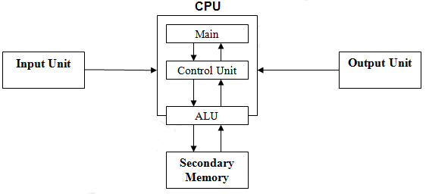
Basic diagram of organizations of a computer

Slide 6
Computer Architecture
Computer architecture can be defined as a set of rules and methods that describe the functionality, management and implementation of computers. To be precise, it is nothing but rules by which a system performs and operates.
Sub-divisions
Computer Architecture can be divided into mainly three categories, which are as follows −
Instruction set Architecture or ISA − Whenever an instruction is given to processor, its role is to read and act accordingly. It allocates memory to instructions and also acts upon memory address mode (Direct Addressing mode or Indirect Addressing mode).
Micro Architecture − It describes how a particular processor will handle and implement instructions from ISA.
System design − It includes the other entire hardware component within the system such as virtualization, multiprocessing.
Role of computer Architecture
The main role of Computer Architecture is to balance the performance, efficiency, cost and reliability of a computer system.

Slide 7
For Example − Instruction set architecture (ISA) acts as a bridge between computer's software and hardware. It works as a programmer's view of a machine.
Computers can only understand binary language (i.e., 0, 1) and users understand high level language (i.e., if else, while, conditions, etc). So to communicate between user and computer, Instruction set Architecture plays a major role here, translating high level language to binary language.
Structure
Let us see the example structure of Computer Architecture as given below.
Generally, computer architecture consists of the following −
Processor
Memory
Peripherals
All the above parts are connected with the help of system bus, which consists of address bus, data bus and control bus.

Slide 8
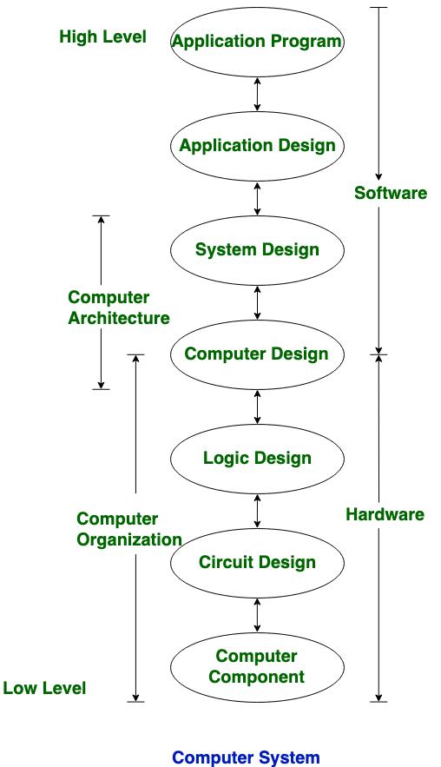
The diagram given below depicts the computer System −

Slide 10
Von Neumann Architecture
Von-Neumann proposed his computer architecture design in 1945 which was later known as Von-Neumann Architecture. It consisted of a Control Unit, Arithmetic, and Logical Memory Unit (ALU), Registers and Inputs/Outputs.
Von Neumann architecture is based on the stored-program computer concept, where instruction data and program data are stored in the same memory. This design is still used in most computers produced today.
A Von Neumann-based computer:
Uses a single processor
Uses one memory for both instructions and data.
Executes programs following the fetch-decode-execute cycle

Slide 11
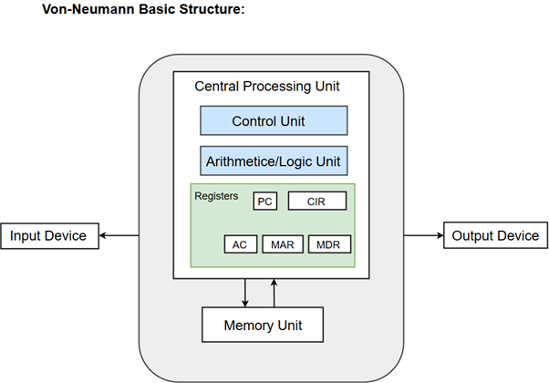
Components of Von-Neumann Model:
Central Processing Unit
Buses
Memory Unit

Slide 12
Central Processing Unit :The part of the Computer that performs the bulk of data processing operations is called the Central Processing Unit and is referred to as the CPU. The Central Processing Unit can also be defined as an electric circuit responsible for executing the instructions of a computer program.
The CPU performs a variety of functions dictated by the type of instructions that are incorporated in the computer.
Buses: Buses are the means by which information is shared between the registers in a multiple-register configuration system. A bus structure consists of a set of common lines, one for each bit of a register, through which binary information is transferred one at a time. Control signals determine which register is selected by the bus during each particular register transfer.
Memory Unit: A memory unit is a collection of storage cells together with associated circuits needed to transfer information in and out of the storage. The memory stores binary information in groups of bits called words. The internal structure of a memory unit is specified by the number of words it contains and the number of bits in each word.

Slide 13
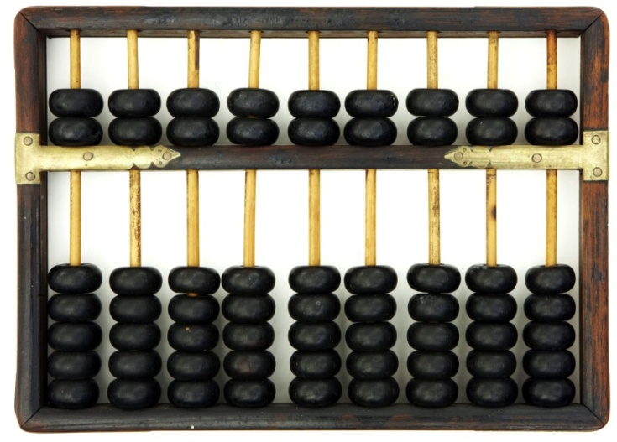
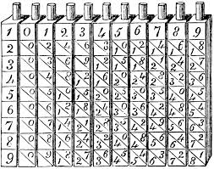
Evolution And Computer Generations
Early History
“Necessity is the mother of invention”, famous saying formed the basis of modern computers
ABACUS: Very first computing device
ABACUS ” also called Soroban invented in
600 BC was the first computing device
Napier Rods: Napier Rods was a card board
multiplication calculator. It was
designed in early 17th century

Slide 14
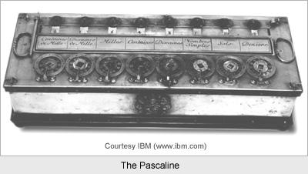
PASCALINE
1642: Blaise Pascal, a French mathematician and philosopher, invented the first operating model of mechanical digital calculator using gears, called the Arithmetic Machine “PASCALINE”
It was for addition, subtraction, and multiplication and division

Slide 15
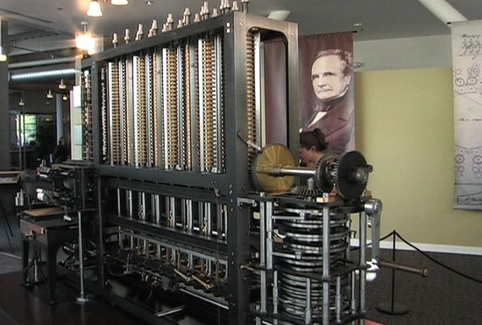
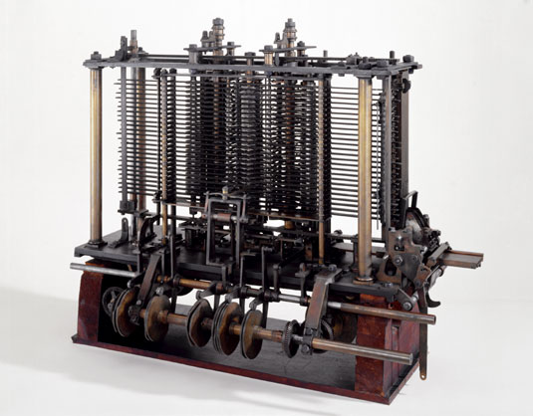
Charles Babbage’s: DIFFERENCE ENGINE & ANALYTICAL ENGINE
Charles Babbage is “The Father of Computers”
1822: His great invention “Difference Engine ” was to perform mathematical calculations
It was fully automatic and commanded by a fixed instruction program
1842: “The Analytical Engine” was a automatic machine. It could do 60 addition per minute
The idea of analytical engine served as a base of modern digital computers

Slide 16
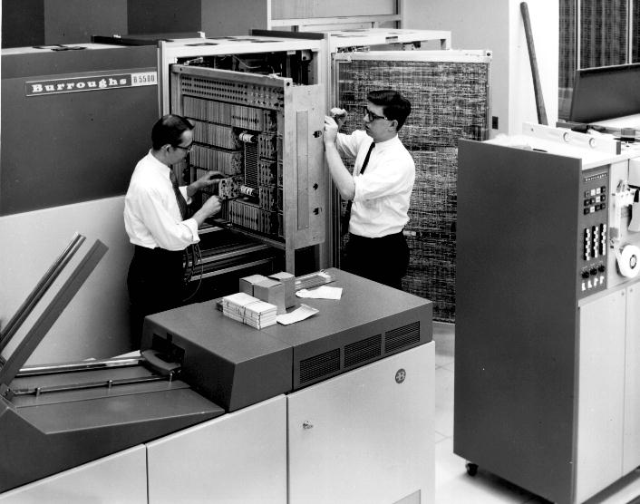
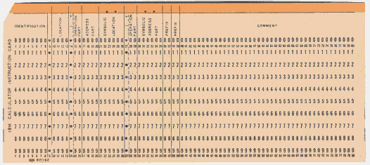
Punched Cards
1890: Dr. Herman Hollerith introduced the first electromechanical, punched-card data processing machine
His company would eventually become International Business Machine (IBM)
This paper based machine represents the origin of computer database software

Slide 17
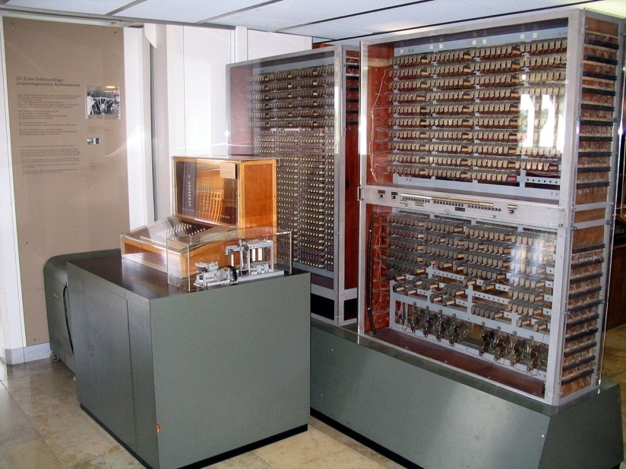
Z3
1941: Conrad Zeus dorm Germany, introduced the first programmable computer
It solved complex engineering equations
It was also first to work on the binary system instead of decimal system

Slide 18
Generations of Computer
The computer has evolved from a large-sized simple calculating machine to a smaller but much more powerful machine.
The evolution of computer to the current state is defined in terms of the generations of computer.
Each generation of computer is designed based on a new technological
development, resulting in better, cheaper and smaller computers that are more powerful, faster and efficient than their predecessors.

Slide 19
Currently, there are five generations of computer. In the following subsections, we will discuss the generations of computer in terms of the technology used by them (hardware and software), computing characteristics (speed, i.e., number of instructions executed per second), physical appearance, and their applications
First Generation Computers (1940-1956)
The first computers used vacuum tubes(a sealed glass tube containing a near-vacuum which allows the free passage of electric current.) for circuitry and magnetic drums for memory.
They were often enormous and taking up entire room.
First generation computers relied on machine language.

Slide 20
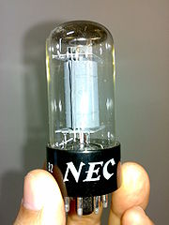
They were very expensive to operate and in addition to using a great deal of electricity, generated a lot of heat, which was often the cause of malfunctions(defect or breakdown).
The UNIVAC and ENIAC computers are examples of first-generation computing devices.

Slide 21
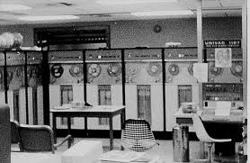
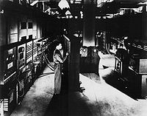
Advantages :
It was only electronic device
First device to hold memory
Disadvantages :
Too bulky i.e large in size
Vacuum tubes burn frequently
They were producing heat
Maintenance problems

Slide 22
Second Generation Computers (1956-1963)
Transistors replaced vacuum tubes and ushered in the second generation of computers.
Second-generation computers moved from cryptic binary machine language to symbolic.
High-level programming languages were also being developed at this time, such as early versions of COBOL and FORTRAN.
These were also the first computers that stored their instructions in their memory.

Slide 23
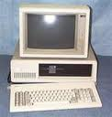
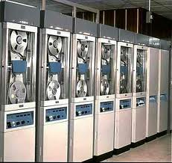
Advantages :
Size reduced considerably
The very fast
Very much reliable
Disadvantages :
They over heated quickly
Maintenance problems

Slide 24
Third Generation Computers (1964-1971)
The development of the integrated circuit was the hallmark of the third generation of computers.
Transistors were miniaturized and placed on silicon chips, called semiconductors.
Instead of punched cards and printouts, users interacted with third generation computers through keyboards and monitors and interfaced with an operating system.
Allowed the device to run many different applications at one time.

Slide 25
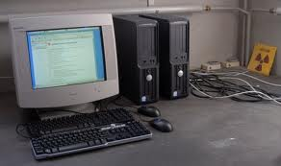
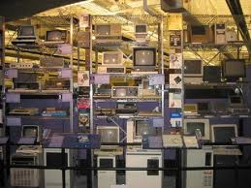
Third generation computers
Advantages :
ICs are very small in size
Improved performance
Production cost cheap
Disadvantages :
ICs are sophisticated

Slide 26
Fourth Generation Computers (1971-present)
The microprocessor brought the fourth generation of computers, as thousands of integrated circuits were built onto a single silicon chip.
The Intel 4004 chip, developed in 1971, located all the components of the computer.
From the central processing unit and memory to input/output controls—on a single chip.
. Fourth generation computers also saw the development of GUIs, the mouse and handheld devices.

Slide 27
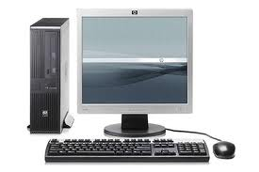
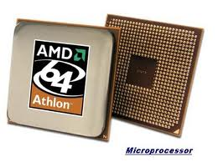
Fourth Generation Computers

Slide 28
Fifth Generation Computers (present and beyond)
Fifth generation computing devices, based on artificial intelligence.
Are still in development, though there are some applications, such as voice recognition.
The use of parallel processing and superconductors is helping to make artificial intelligence a reality.
The goal of fifth-generation computing is to develop devices that respond to natural language input and are capable of learning and self-organization.

Slide 29
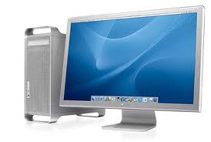
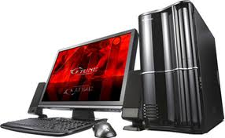
Fifth Generation Computers

Slide 30
Fixed Point and Floating Point Number Representations
Digital Computers use Binary number system to represent all types of information inside the computers. Alphanumeric characters are represented using binary bits (i.e., 0 and 1). Digital representations are easier to design, storage is easy, accuracy and precision are greater.
There are various types of number representation techniques for digital number representation, for example: Binary number system, octal number system, decimal number system, and hexadecimal number system etc. But Binary number system is most relevant and popular for representing numbers in digital computer system.

Slide 31
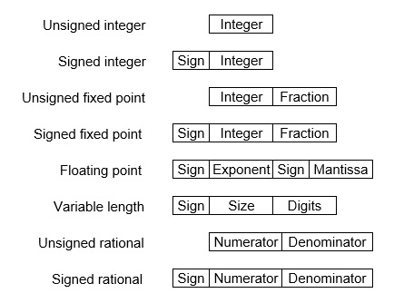
Storing Real Number
These are structures as following below −
There are two major approaches to store real numbers (i.e., numbers with fractional component) in modern computing. These are (i) Fixed Point Notation and (ii) Floating Point Notation. In fixed point notation, there are a fixed number of digits after the decimal point, whereas floating point number allows for a varying number of digits after the decimal point.

Slide 32
Fixed-Point Representation −This representation has fixed number of bits for integer part and for fractional part. For example, if given fixed-point representation is IIII.FFFF, then you can store minimum value is 0000.0001 and maximum value is 9999.9999. There are three parts of a fixed-point number representation: the sign field, integer field, and fractional field.
We can represent these numbers using:
Signed representation: range from -(2^{(k-1)}-1) to (2^{(k-1)}-1), for k bits.
1’s complement representation: range from -(2^{(k-1)}-1) to (2^{(k-1)}-1), for k bits.
2’s complementation representation: range from -(2^{(k-1)}) to (2^{(k-1)}-1), for k bits.
2’s complementation representation is preferred in computer system because of unambiguous property and easier for arithmetic operations.

Slide 33
Example −Assume number is using 32-bit format which reserve 1 bit for the sign, 15 bits for the integer part and 16 bits for the fractional part.
Then, -43.625 is represented as following:
Where, 0 is used to represent + and 1 is used to represent. 000000000101011 is 15 bit binary value for decimal 43 and 1010000000000000 is 16 bit binary value for fractional 0.625.
The advantage of using a fixed-point representation is performance and disadvantage is relatively limited range of values that they can represent. So, it is usually inadequate for numerical analysis as it does not allow enough numbers and accuracy. A number whose representation exceeds 32 bits would have to be stored inexactly.

Slide 34
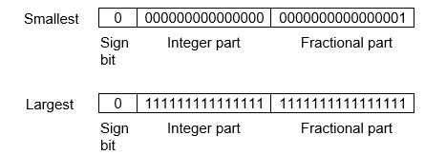
The advantage of using a fixed-point representation is performance and disadvantage is relatively limited range of values that they can represent. So, it is usually inadequate for numerical analysis as it does not allow enough numbers and accuracy. A number whose representation exceeds 32 bits would have to be stored inexactly.
These are above smallest positive number and largest positive number which can be store in 32-bit representation as given above format. Therefore, the smallest positive number is 2⁻¹⁶ ≈ 0.000015 approximate and the largest positive number is (2¹⁵-1)+(1-2⁻¹⁶)=2¹⁵(1-2⁻¹⁶) =32768, and gap between these numbers is 2⁻¹⁶.
We can move the radix point either left or right with the help of only integer field is 1.`

Slide 35
Floating-Point Representation −
This representation does not reserve a specific number of bits for the integer part or the fractional part. Instead it reserves a certain number of bits for the number (called the mantissa or significand) and a certain number of bits to say where within that number the decimal place sits (called the exponent).
The floating number representation of a number has two part: the first part represents a signed fixed point number called mantissa. The second part of designates the position of the decimal (or binary) point and is called the exponent. The fixed point mantissa may be fraction or an integer. Floating -point is always interpreted to represent a number in the following form: Mxr^{e}.
Only the mantissa m and the exponent e are physically represented in the register (including their sign). A floating-point binary number is represented in a similar manner except that is uses base 2 for the exponent. A floating-point number is said to be normalized if the most significant digit of the mantissa is 1.

Slide 36
So, actual number is (-1)^{s}(1+m)x2^{(e-Bias)}, where s is the sign bit, m is the mantissa, e is the exponent value, and Bias is the bias number.
Note that signed integers and exponent are represented by either sign representation, or one’s complement representation, or two’s complement representation.
The floating point representation is more flexible. Any non-zero number can be represented in the normalized form of ±(1.b₁b₂b₃ ...)₂x2^{n} This is normalized form of a number x.
Example −Suppose number is using 32-bit format: the 1 bit sign bit, 8 bits for signed exponent, and 23 bits for the fractional part. The leading bit 1 is not stored (as it is always 1 for a normalized number) and is referred to as a “hidden bit”.
Then −53.5 is normalized as -53.5=(-110101.1)₂=(-1.101011)x2⁵ , which is represented as following below,
Where 00000101 is the 8-bit binary value of exponent value +5.
Note that 8-bit exponent ﬁeld is used to store integer exponents -126 ≤ n ≤ 127.

Slide 37
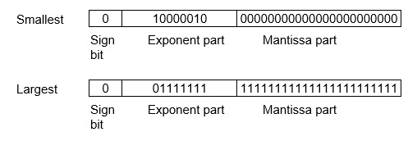
The smallest normalized positive number that ﬁts into 32 bits is (1.00000000000000000000000)₂x2⁻¹²⁶=2⁻¹²⁶≈1.18x10⁻³⁸ , and largest normalized positive number that ﬁts into 32 bits is (1.11111111111111111111111)₂x2¹²⁷=(2²⁴-1)x2¹⁰⁴ ≈ 3.40x10³⁸ . These numbers are represented as following below,
The precision of a ﬂoating-point format is the number of positions reserved for binary digits plus one (for the hidden bit). In the examples considered here the precision is 23+1=24.
The gap between 1 and the next normalized ﬂoating-point number is known as machine epsilon. the gap is (1+2⁻²³)-1=2⁻²³for above example, but this is same as the smallest positive ﬂoating-point number because of non-uniform spacing unlike in the ﬁxed-point scenario.
Note that non-terminating binary numbers can be represented in floating point representation, e.g., 1/3 = (0.010101 ...)₂ cannot be a ﬂoating-point number as its binary representation is non-terminating.

Slide 38
IEEE Floating point Number Representation
IEEE (Institute of Electrical and Electronics Engineers) has standardized Floating-Point Representation as following diagram.
So, actual number is (-1)^{s}(1+m)x2^{(e-Bias)}, where s is the sign bit, m is the mantissa, e is the exponent value, and Bias is the bias number. The sign bit is 0 for positive number and 1 for negative number. Exponents are represented by or two’s complement representation.
According to IEEE 754 standard, the floating-point number is represented in following ways:
Half Precision (16 bit): 1 sign bit, 5 bit exponent, and 10 bit mantissa
Single Precision (32 bit): 1 sign bit, 8 bit exponent, and 23 bit mantissa
Double Precision (64 bit): 1 sign bit, 11 bit exponent, and 52 bit mantissa
Quadruple Precision (128 bit): 1 sign bit, 15 bit exponent, and 112 bit mantissa

Slide 39
Special Value Representation
There are some special values depended upon different values of the exponent and mantissa in the IEEE 754 standard.
All the exponent bits 0 with all mantissa bits 0 represents 0. If sign bit is 0, then +0, else -0.
All the exponent bits 1 with all mantissa bits 0 represents infinity. If sign bit is 0, then +∞, else -∞.
All the exponent bits 0 and mantissa bits non-zero represents denormalized number.
All the exponent bits 1 and mantissa bits non-zero represents error.

Slide 40
Booth's Multiplication Algorithm
bits 0's in the multiplier that requires no additional bit only shift the right-most string bits and a string of 1'sThe booth algorithm is a multiplication algorithm that allows us to multiply the two signed binary integers in 2's complement, respectively. It is also used to speed up the performance of the multiplication porn. It is very efficient too. It works on the string in a multiplier bit weight 2^{k} to weight 2^{m} that can be considered as 2^{k+ 1} - 2^{m}.
In the below flowchart, initially, AC and Q_{n + 1} bits are set to 0, and the SC is a sequence counter that represents the total bits set n, which is equal to the number of bits in the multiplier. There are BR that represent the multiplicand bits, and QR represents the multiplier bits. repeated, equal to the number of bits (n).

Slide 41
After that, we encountered two bits of the multiplier as Q_{n} and Q_{n + 1}, where Qn represents the last bit of QR, and Q_{n + 1} represents the incremented bit of Qn by 1. Suppose two bits of the multiplier is equal to 10; it means that we have to subtract the multiplier from the partial product in the accumulator AC and then perform the arithmetic shift operation (ashr). If the two of the multipliers equal to 01, it means we need to perform the addition of the multiplicand to the partial product in accumulator AC and then perform the arithmetic shift operation (ashr), including Q_{n + 1}. The arithmetic shift operation is used in Booth's algorithm to shift AC and QR bits to the right by one and remains the sign bit in AC unchanged. And the sequence counter is continuously decremented till the computational loop is

Slide 42
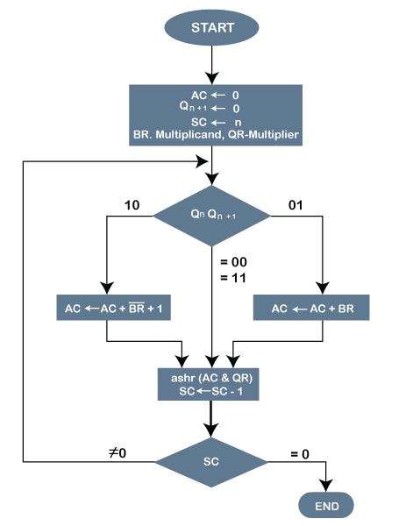
Following is the pictorial representation of the Booth's Algorithm:

Slide 43
Working of the Booth Algorithm:-
Set the Multiplicand and Multiplier binary bits as M and Q, respectively.
Initially, we set the AC and Q_{n + 1} registers value to 0.
SC represents the number of Multiplier bits (Q), and it is a sequence counter that is continuously decremented till equal to the number of bits (n) or reached to 0.
A Qn represents the last bit of the Q, and the Q_{n+1} shows the incremented bit of Qn by 1.
On each cycle of the booth algorithm, Q_{n} and Q_{n + 1} bits will be checked on the following parameters as follows:
1.When two bits Q_{n} and Q_{n + 1} are 00 or 11, we simply perform the arithmetic shift right operation (ashr) to the partial product AC. And the bits of Qn and Q_{n + 1} is incremented by 1 bit.

Slide 44
2. If the bits of Q_{n} and Q_{n + 1} is shows to 01, the multiplicand bits (M) will be added to the AC (Accumulator register). After that, we perform the right shift operation to the AC and QR bits by 1.
3. If the bits of Q_{n} and Q_{n + 1} is shows to 10, the multiplicand bits (M) will be subtracted from the AC (Accumulator register). After that, we perform the right shift operation to the AC and QR bits by 1.
4. The operation continuously works till we reached n - 1 bit in the booth algorithm.
5.Results of the Multiplication binary bits will be stored in the AC and QR registers.

Slide 45
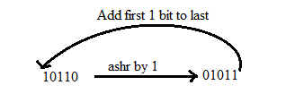
There are two methods used in Booth's Algorithm:
1. RSC (Right Shift Circular)
It shifts the right-most bit of the binary number, and then it is added to the beginning of the binary bits.
2. RSA (Right Shift Arithmetic)
It adds the two binary bits and then shift the result to the right by 1-bit position.
Example: 0100 + 0110 => 1010, after adding the binary number shift each bit by 1 to the right and put the first bit of resultant to the beginning of the new bit.

Slide 46
Example: Multiply the two numbers 7 and 3 by using the Booth's multiplication algorithm.
Q_{n} | Q_{n + 1} | M = (0111) M' + 1 = (1001) & Operation | AC | Q | Q_{n + 1} | SC
1 | 0 | Initial | 0000 | 0011 | 0 | 4
 |  | Subtract (M' + 1) | 1001
 |  |  | 1001
 |  | Perform Arithmetic Right Shift operations (ashr) | 1100 | 1001 | 1 | 3
1 | 1 | Perform Arithmetic Right Shift operations (ashr) | 1110 | 0100 | 1 | 2
0 | 1 | Addition (A + M) | 0111
 |  |  | 0101 | 0100
 |  | Perform Arithmetic right shift operation | 0010 | 1010 | 0 | 1
0 | 0 | Perform Arithmetic right shift operation | 0001 | 0101 | 0 | 0

Slide 47
Here we have two numbers, 7 and 3. First of all, we need to convert 7 and 3 into binary numbers like 7 = (0111) and 3 = (0011). Now set 7 (in binary 0111) as multiplicand (M) and 3 (in binary 0011) as a multiplier (Q). And SC (Sequence Count) represents the number of bits, and here we have 4 bits, so set the SC = 4. Also, it shows the number of iteration cycles of the booth's algorithms and then cycles run SC = SC - 1 time.
After the chart of solution-
The numerical example of the Booth's Multiplication Algorithm is 7 x 3 = 21 and the binary representation of 21 is 10101. Here, we get the resultant in binary 00010101. Now we convert it into decimal, as (000010101)₁₀ = 2*4 + 2*3 + 2*2 + 2*1 + 2*0 => 21.

Slide 48
Restoring Division Algorithm for Unsigned Integer
Restoring division is usually performed on the fixed point fractional numbers. When we perform division operations on two numbers, the division algorithm will give us two things, i.e., quotient and remainder. This algorithm is based on the assumption that 0 < D < N. With the help of digit set {0, 1}, the quotient digit q will be formed in the restoring division algorithm. The division algorithm is generally of two types, i.e., fast algorithm and slow algorithm. Goldschmidt and Newton-Raphson are the types of fast division algorithm, and STR algorithm, restoring algorithm, non-performing algorithm, and the non-restoring algorithm are the types of slow division algorithm.
We are going to perform restoring algorithm with the help of an unsigned integer. We are using restoring term because we know that the value of register A will be restored after each iteration. We will also try to solve this problem using the flow chart and apply bit operations.

Slide 49
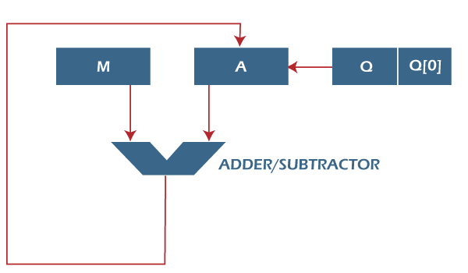
Here, register Q is used to contain the quotient, and register A is used to contain the remainder. Here, the divisor will be loaded into the register M, and n-bit divided will be loaded into the register Q. 0 is the starting value of a register. The values of these types of registers are restored at the time of iteration. That's why it is known as restoring.

Slide 50
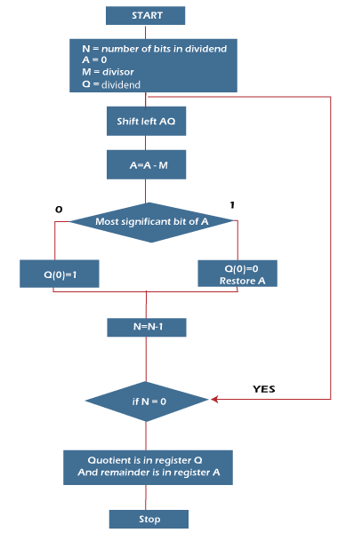
Flowchart of Restoring Division Algorithm for Unsigned Integer

Slide 51
Examples:
Perform Division Restoring Algorithm Dividend = 11 Divisor = 3
Example: Perform Division Restoring Algorithm Dividend = Divisor 3
Let’s pick the step involved:
Step-1: First the registers are initialized with corresponding values (Q = Dividend, M = Divisor, A = 0, n = number of bits in dividend)
Step-2: Then the content of register A and Q is shifted left as if they are a single unit
Step-3: Then content of register M is subtracted from A and result is stored in A

Slide 52
Step-4: Then the most significant bit of the A is checked if it is 0 the least
significant bit of Q is set to 1 otherwise if it is 1 the least significant bit of Q
is set to 0 and value of register A is restored i.e the value of A before the
subtraction with M
Step-5: The value of counter n is decremented
Step-6: If the value of n becomes zero we get of the loop otherwise we repeat
from step 2
Step-7: Finally, the register Q contain the quotient and A contain remainder

Slide 53
n | M | A | Q | Operation
4 | 00011 | 00000 | 1011 | initialize
 | 00011 | 00001 | 011_ | shift left AQ
 | 00011 | 11110 | 011_ | A=A-M
 | 00011 | 00001 | 0110 | Q[0]=0 And restore A
3 | 00011 | 00010 | 110_ | shift left AQ
 | 00011 | 11111 | 110_ | A=A-M
 | 00011 | 00010 | 1100 | Q[0]=0
2 | 00011 | 00101 | 100_ | shift left AQ
 | 00011 | 00010 | 100_ | A=A-M
 | 00011 | 00010 | 1001 | Q[0]=1
1 | 00011 | 00101 | 001_ | shift left AQ
 | 00011 | 00010 | 001_ | A=A-M
 | 00011 | 00010 | 0011 | Q[0]=1
Remember to restore the value of A most significant bit of A is 1. As that register Q contain the quotient, i.e. 3 and register A contain remainder 2.

Slide 54
Non-Restoring Division Algorithm for Unsigned Integer
Instead of the quotient digit set {0, 1}, the set {-1, 1} is used by the non-restoring division. The non-restoring division algorithm is more complex as compared to the restoring division algorithm. But when we implement this algorithm in hardware, it has an advantage, i.e., it contains only one decision and addition/subtraction per quotient bit. After performing the subtraction operation, there will not be any restoring steps. Due to this, the numbers of operations basically cut down up to half. Because of the less operation, the execution of this algorithm will be fast. This algorithm basically performs simple operations such as addition, subtraction. In this method, we will use the sign bit of register A. 0 is the starting value/bit of register A.

Slide 55
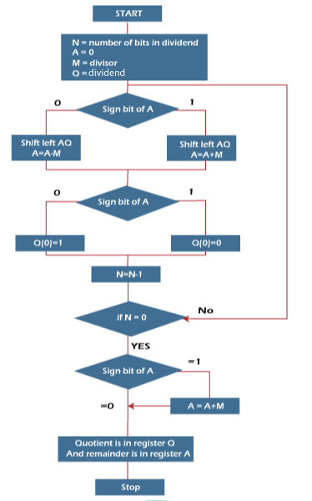
Flowchart of Non-Restoring Division Algorithm for Unsigned Integer

Slide 56
Steps of the non-restoring division algorithm, which are described as follows:
Step 1: In this step, the corresponding value will be initialized to the registers, i.e., register A will contain value 0, register M will contain Divisor,
register Q will contain Dividend, and N is used to specify the number of bits in dividend.
Step 2: In this step, we will check the sign bit of A.
Step 3: If this bit of register A is 1, then shift the value of AQ through left, and perform A = A + M. If this bit is 0, then shift the value of AQ into
left and perform A = A - M. That means in case of 0, the 2's complement of M is added into register A, and the result is stored into A.
Step 4: Now, we will check the sign bit of A again.

Slide 57
Step 5: If this bit of register A is 1, then Q[0] will become 0. If this bit is 0, then Q[0] will become
1. Here Q[0] indicates the least significant bit of Q.
Step 6: After that, the value of N will be decremented. Here N is used as a counter.
Step 7: If the value of N = 0, then we will go to the next step. Otherwise, we have to again go
to step 2.
Step 8: We will perform A = A + M if the sign bit of register A is 1.
Step 9: This is the last step. In this step, register A contains the remainder, and register Q contains the quotient.

Slide 58
Example : Dividend = 11, Divisor = 3, -M = 11101
N | M | A | Q | Action
4 | 00011 | 00000 | 1011 | Begin
 | 00011 | 00001 | 011_ | Shift left AQ
 | 00011 | 11110 | 011_ | A = A - M
3 | 00011 | 11110 | 0110 | Q[0] = 0
 | 00011 | 11100 | 110_ | Shift left AQ
 | 00011 | 11111 | 110_ | A = A + M
2 | 00011 | 11111 | 1100 | Q[0] = 0
 | 00011 | 11111 | 100_ | Shift left AQ
 | 00011 | 00010 | 100_ | A = A +M
1 | 00011 | 00010 | 1001 | Q[0] = 1
 | 00011 | 00101 | 001_ | Shift left AQ
 | 00011 | 00010 | 001_ | A = A - M
0 | 00011 | 00010 | 0011 | Q[0] = 1
So, register A contains the remainder 2, and register Q contains the quotient 3.

Slide 59
Addition and Subtraction with signed magnitude
A signed-magnitude method is used by computers to implement floating-point operations. Signed-2’s complement method is used by most computers for arithmetic operations executed on integers. In this approach, the leftmost bit in the number is used for signifying the sign; 0 indicates a positive integer, and 1 indicates a negative integer. The remaining bits in the number supported the magnitude of the number.
10011000
Example: -2410 is defined as −
In this example, the leftmost bit 1 defines negative, and the magnitude is 24.
The magnitude for both positive and negative values is the same, but they change only with their signs.
The range of values for the sign and magnitude representation is from -127 to 127.
There are eight conditions to consider while adding or subtracting signed numbers. These conditions are based on the operations implemented and the sign of the numbers.

Slide 60
The table displays the algorithm for addition and subtraction. The first column in the table displays these conditions. The other columns of the table define the actual operations to be implemented with the magnitude of numbers. The last column of the table is needed to avoid a negative zero. This defines that when two same numbers are subtracted, the output must not be - 0. It should consistently be +0.
In the table, the magnitude of the two numbers is defined by P and Q.
Operations | Addition of Magnitudes | Subtraction of Magnitudes
(+P) + (+Q) | +(P+Q) | P>Q | P<Q | P=Q
(+P) + (-Q) |  | +(P-Q) | -(Q-P) | +(P-Q)
(-P) + (+Q) |  | -(P-Q) | +(Q-P) | +(P-Q)
(-P) + (-Q) | -(P+Q)
(+P) - (+Q) |  | +(P-Q) | -(Q-P) | +(P-Q)
(+P) - (-Q) | +(P+Q)
(-P) - (+Q) | -(P+Q)
(-P) - (-Q) |  | -(P-Q) | +(Q-P) | +(P-Q)

Slide 61
As display in the table, the addition algorithm states that −
When the signs of P and Q are equal, add the two magnitudes and connect the sign of P to the output.
When the signs of P and Q are different, compare the magnitudes and subtract the smaller number from the greater number.
The signs of the output have to be equal as P in case P > Q or the complement of the sign of P in case P < Q.
When the two magnitudes are equal, subtract Q from P and modify the sign of the output to positive.
The subtraction algorithm states that −
When the signs of P and Q are different, add the two magnitudes and connect the signs of P to the output.
When the signs of P and Q are the same, compare the magnitudes and subtract the smaller number from the greater number.
The signs of the output have to be equal as P in case P > Q or the complement of the sign of P in case P < Q.
When the two magnitudes are equal, subtract Q from P and modify the sign of the output to positive.

Slide 62
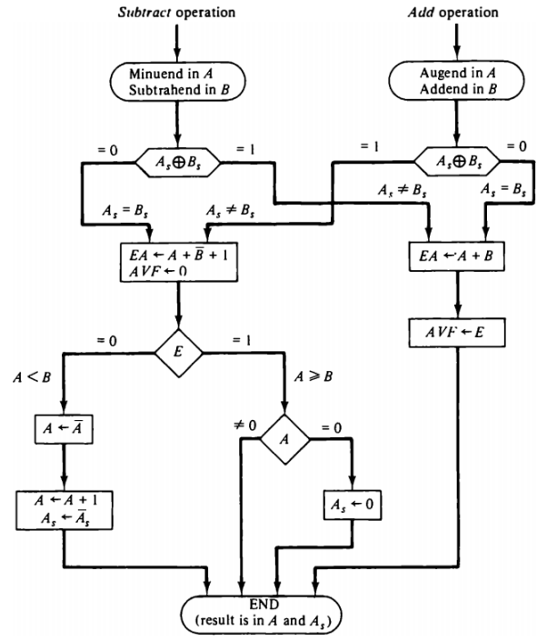
Addition and Subtraction with signed magnitude flowchart

Slide 63
Example 1
Let's add two values, +3 and +2, using the signed magnitude representation.
Solution
We represent the given operands as shown below:
+3 = 0 0112
+2 = 0 0102
From the flowchart, we follow that A_{s} xor B_{s} = 0. This implies that A_{s} = B_{s}
Also, according to the table,
So we do the addition of the magnitude of both operands.
Mag(+3) + Mag(+2) = 011₂ + 010₂ = 101₂ = Mag(5)
Now the sign of the result will be that of A_{s}
Therefore, +3 + (+2) = 0 101₂ = +5
Operations | Addition of Magnitudes | Subtraction of Magnitudes
(+P) + (+Q) | +(P+Q)

Slide 64
Example 2
Let's subtract two values, +3 and +2, using the signed magnitude representation.
Solution
We represent the given operands as shown below:
+3 = 0 011₂
+2 = 0 010₂
From the flowchart, we follow that A_{s} xor B_{s} = 0. This implies that As = Bs
Also according to the table,
Since the magnitude of P > Q,
We get results by +(P-Q).
Mag(Result) = 011 + (010)’ + 1 = 011 + 101 + 1 = (001)
SignBit(Result) = 0
Therefore, +3 - (+2) = +(+3-2) = +1
Operations | Addition of Magnitudes | Subtraction of Magnitudes
 |  | P>Q | P<Q | P=Q
(+P) - (+Q) |  | +(P-Q) | -(Q-P) | +(P-Q)

Slide 65
Memory Hierarchy
A memory unit is an essential component in any digital computer since it is needed for storing programs and data.
Typically, a memory unit can be classified into two categories:
The memory unit that establishes direct communication with the CPU is called Main Memory. The main memory is often referred to as RAM (Random Access Memory).
The memory units that provide backup storage are called Auxiliary Memory. For instance, magnetic disks and magnetic tapes are the most commonly used auxiliary memories.
Apart from the basic classifications of a memory unit, the memory hierarchy consists all of the storage devices available in a computer system ranging from the slow but high-capacity auxiliary memory to relatively faster main memory.

Slide 66
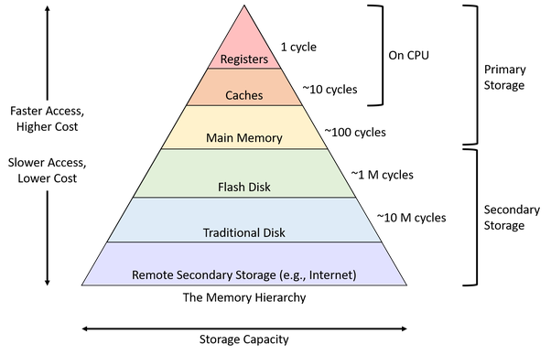

Slide 67
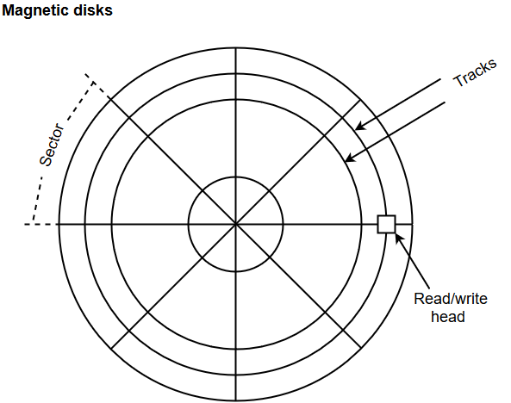
Auxiliary Memory :-
Auxiliary memory is known as the lowest-cost, highest-capacity and slowest-access storage in a computer system. Auxiliary memory provides storage for programs and data that are kept for long-term storage or when not in immediate use. The most common examples of auxiliary memories are magnetic tapes and magnetic disks.
A magnetic disk is a digital computer memory that uses a magnetization process to write, rewrite and access data. For example, hard drives, zip disks, and floppy disks.
Magnetic tape is a storage medium that allows for data archiving, collection, and backup for different kinds of data.

Slide 68
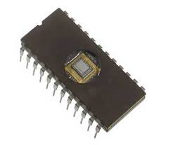
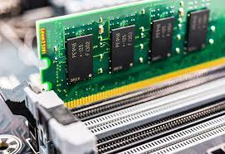
Main Memory:-
The main memory acts as the central storage unit in a computer system. It is a relatively large and fast memory which is used to store programs and data during the run time operations.
The primary technology used for the main memory is based on semiconductor integrated circuits. The integrated circuits for the main memory are classified into two major units.
1.RAM (Random Access Memory) integrated circuit chips
2.ROM (Read Only Memory) integrated circuit chips
ROM
RAM

Slide 69
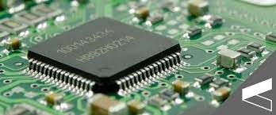
Cache Memory:-
Cache memory is a high-speed memory, which is small in size but faster than the main memory (RAM). The CPU can access it more quickly than the primary memory. So, it is used to synchronize with high-speed CPU and to improve its performance.
Cache memory can only be accessed by CPU. It can be a reserved part of the main memory or a storage device outside the CPU. It holds the data and programs which are frequently used by the CPU. So, it makes sure that the data is instantly available for CPU whenever the CPU needs this data. In other words, if the CPU finds the required data or instructions in the cache memory, it doesn't need to access the primary memory (RAM). Thus, by acting as a buffer between RAM and CPU, it speeds up the system performance.

Slide 70
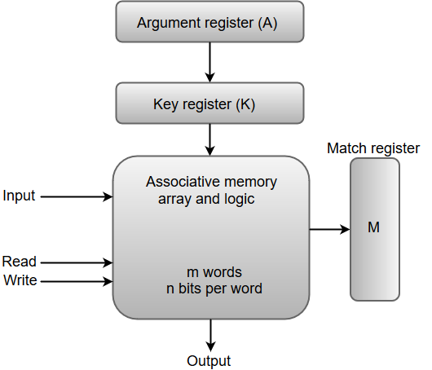
Associative Memory:-
An associative memory can be considered as a memory unit whose stored data can be identified for access by the content of the data itself rather than by an address or memory location.
Associative memory is often referred to as Content Addressable Memory (CAM).
When a write operation is performed on associative memory, no address or memory location is given to the word. The memory itself is capable of finding an empty unused location to store the word.
On the other hand, when the word is to be read from an associative memory, the content of the word, or part of the word, is specified. The words which match the specified content are located by the memory and are marked for reading.
The following diagram shows the block representation of an Associative memory.

Slide 71
Virtual Memory:-
Virtual Memory is a storage scheme that provides user an illusion of having a very big main memory. This is done by treating a part of secondary memory as the main memory.
In this scheme, User can load the bigger size processes than the available main memory by having the illusion that the memory is available to load the process.
Instead of loading one big process in the main memory, the Operating System loads the different parts of more than one process in the main memory.
By doing this, the degree of multiprogramming will be increased and therefore, the CPU utilization will also be increased.

